Slide 1
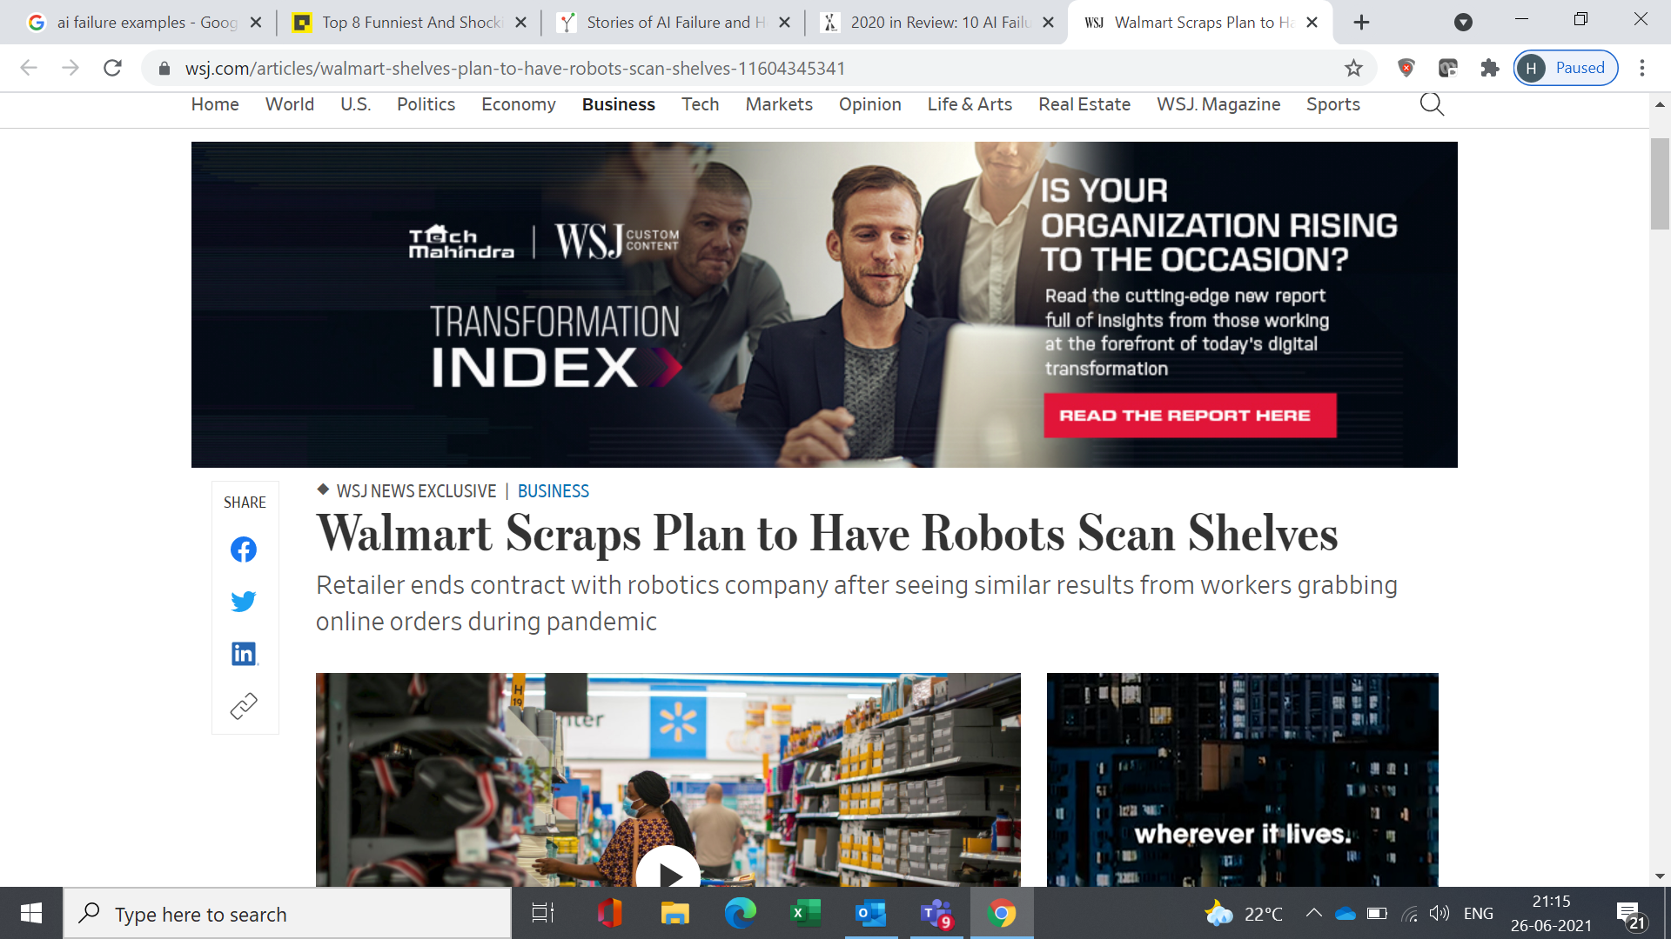

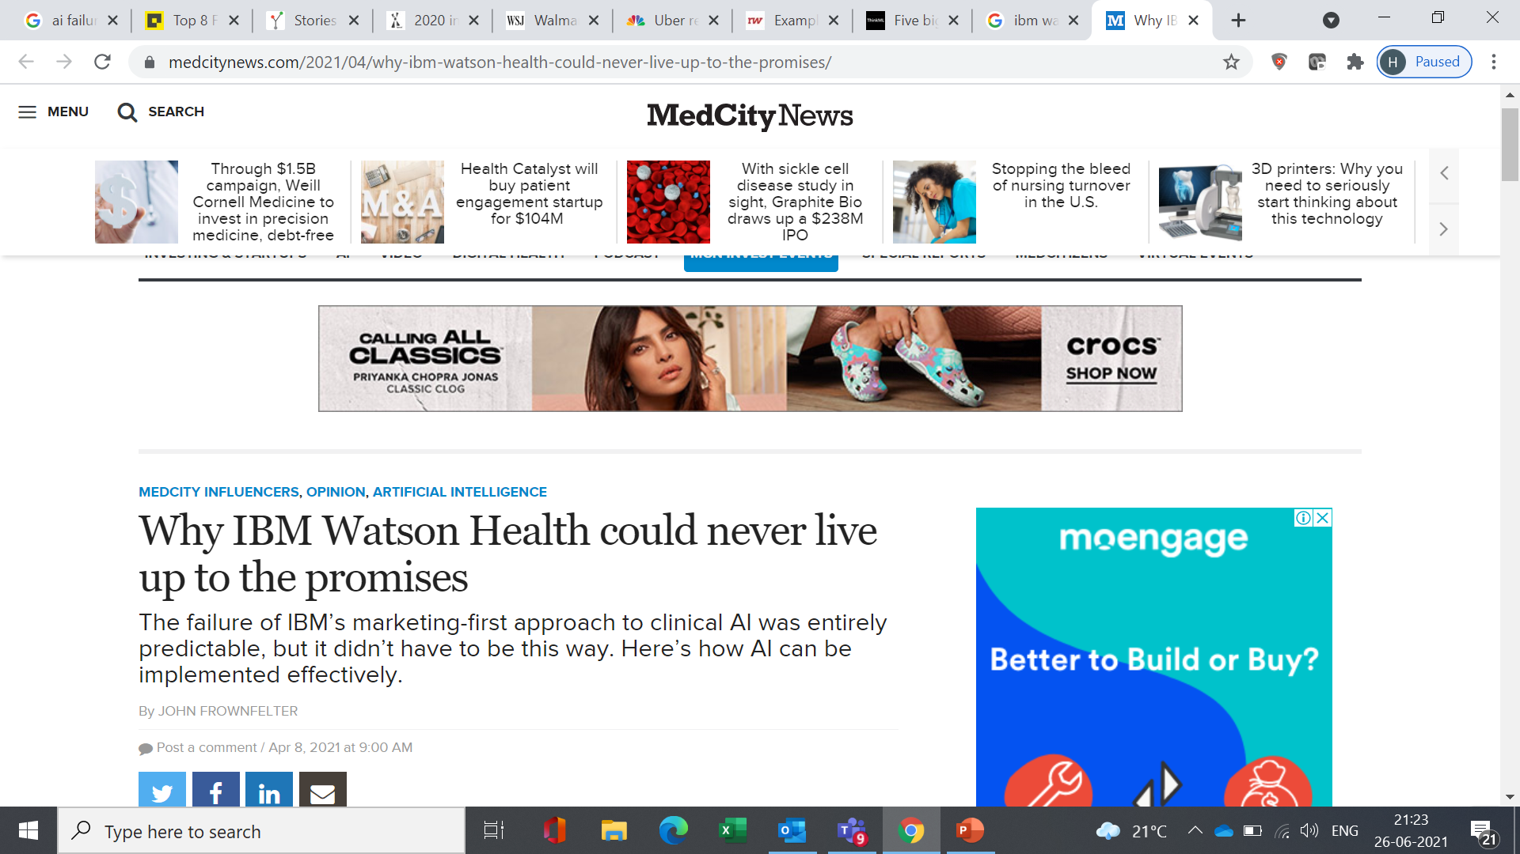
WHY DO WE NEED TO DISCUS AI FOR LEADERS?
Walmart ended the partnership because it found different, sometimes simpler solutions that proved just as useful. In addition, Walmart U.S. chief executive John Furner has concerns about how shoppers react to seeing a robot working in a store
Given the necessary cost cuts and the increased focus on core, we have decided to wind down the Incubator and AI Labs and pursue strategic alternatives for Uber Works.
When applied in real world, IBM found that its ground-breaking innovation is no counterpart for the untidy truth of the present medical care framework. A doctor at Jupiter Hospital in Florida told IBM representatives according to the study:
“We bought it for marketing and with hopes that you would achieve the vision. We can’t use it in many cases."

Slide 2
Background

Slide 3
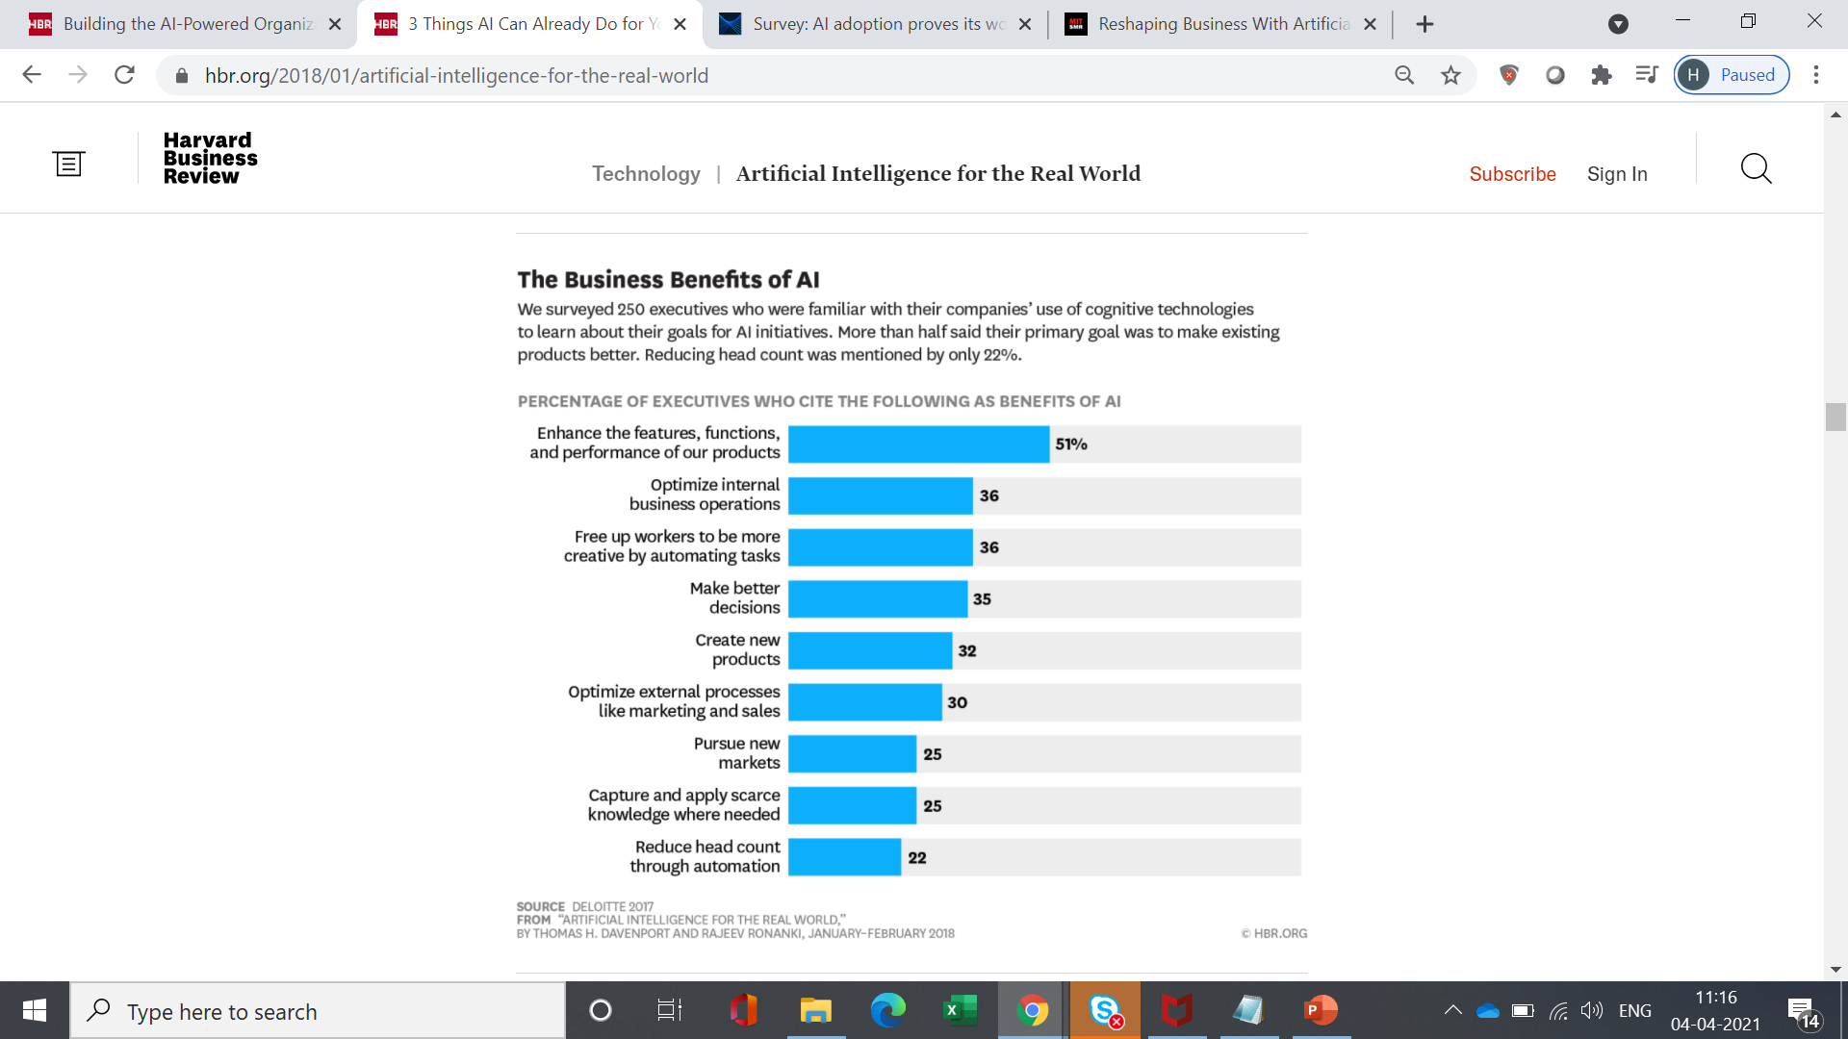
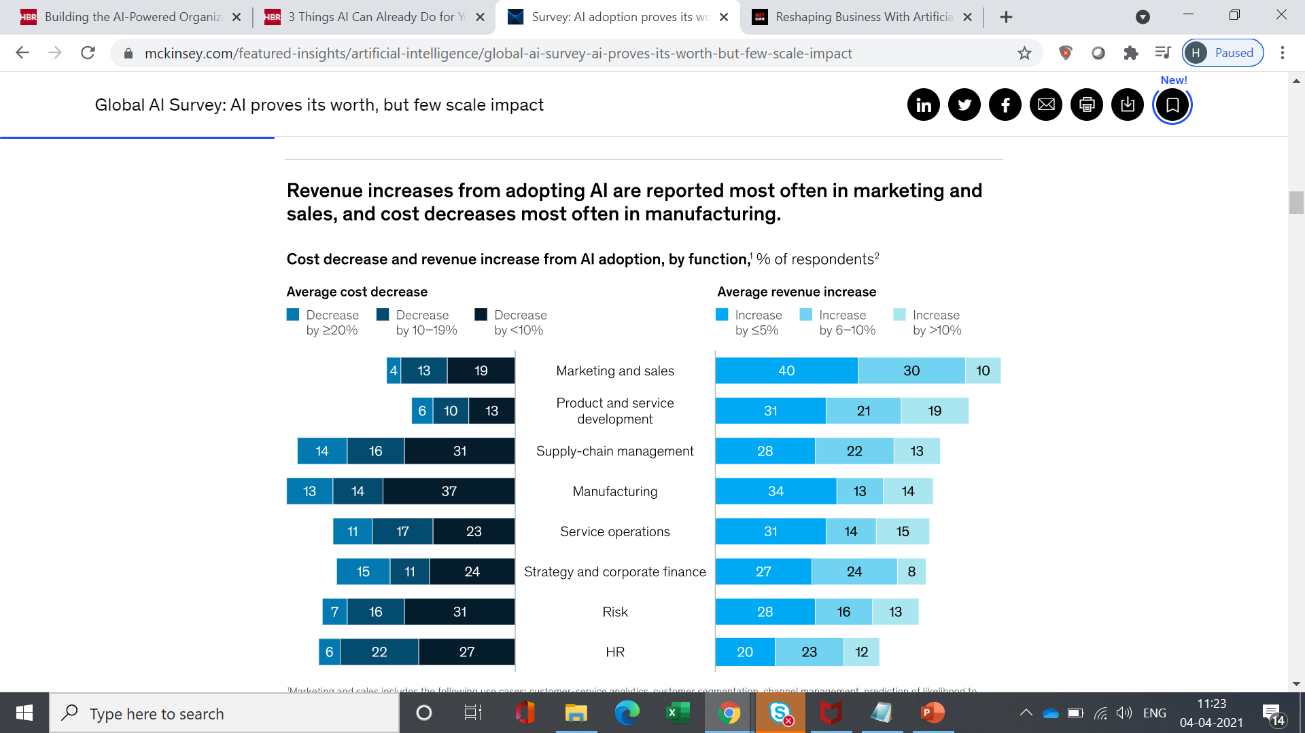
An outside-in view of how AI and ML are shaping organizations
Opportunities – areas where AI is expected to make the maximum impact
Opportunities – functions where AI is expected to make the maximum impact
https://www.mckinsey.com/featured-insights/artificial-intelligence/global-ai-survey-ai-proves-its-worth-but-few-scale-impact

Slide 4
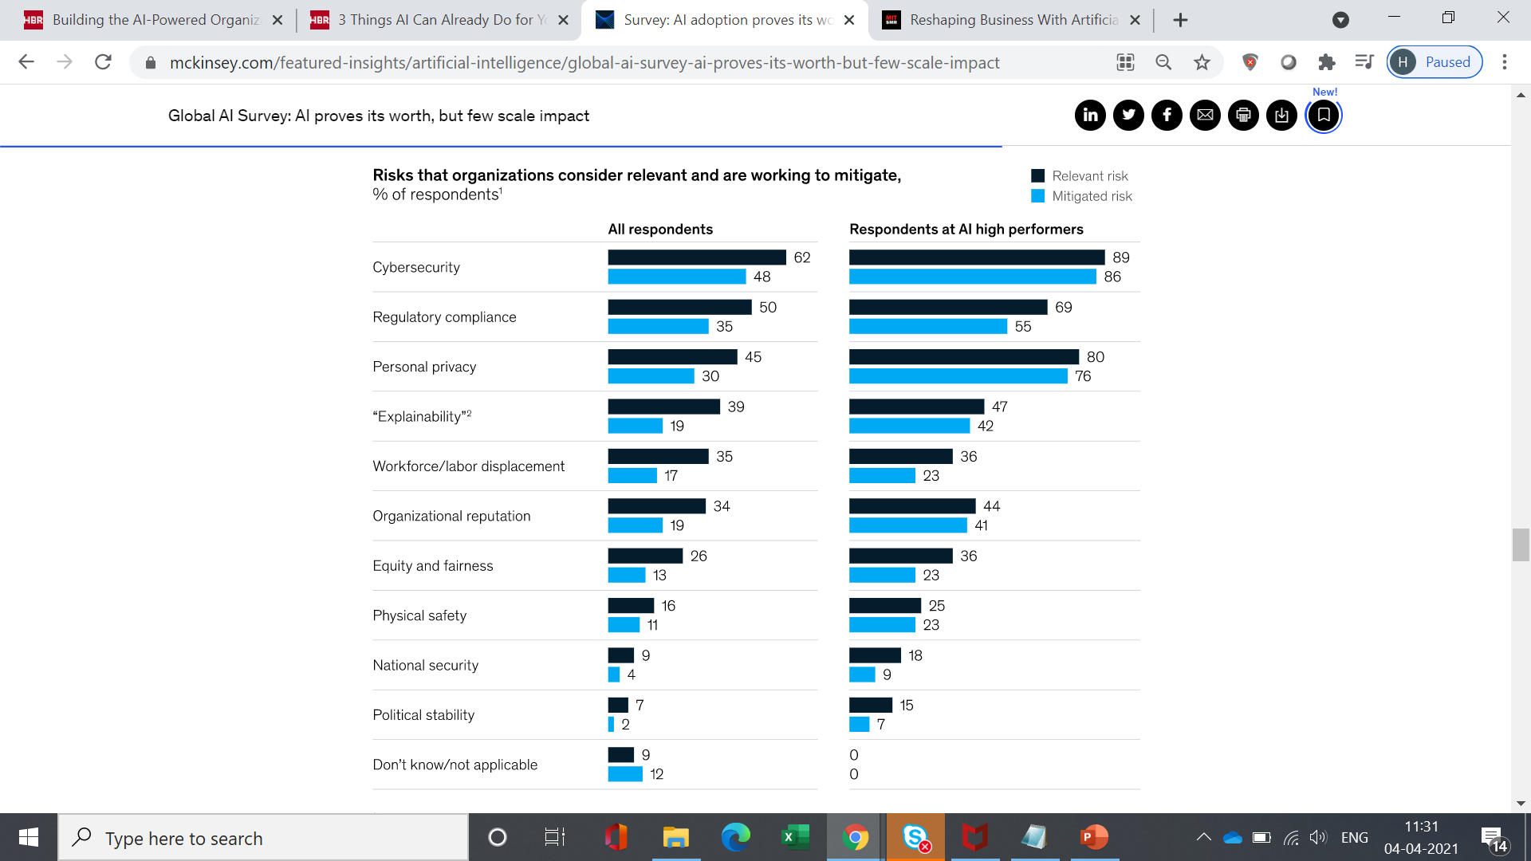

An outside-in view – the challenges of AI adoption
Challenges
Risks
https://www.mckinsey.com/featured-insights/artificial-intelligence/global-ai-survey-ai-proves-its-worth-but-few-scale-impact

Slide 5
TYPES OF AI INITIATIVES – A USE-CASE-DRIVEN CLASSIFICATION – TYPE OF IMPACT
While there are many different frameworks and approaches to classifying AI initiatives, for our discussion, we will use a classification based on the type of the use case. This is based on our proprietary approach to conceptualising AI initiatives
Type of Impact
No. of Projects/Initiatives
Impact of the Initiative
Proof of concept
Incremental impact
Incremental innovation
Transformation
High
Not known
Overall impact of each type of initiative could still be equally high
High
Low
Mid
Mid
Low
High

Slide 6
TYPES OF AI INITIATIVES – AN USE-CASE-DRIVEN CLASSIFICATION – TYPE OF SOLUTION
While there are many different frameworks and approaches to classifying AI initiatives, for our discussion, we will use a classification based on the type of the use case. This is based on our proprietary approach to conceptualising AI initiatives
Subject Matter Expertise
Decision Automation
Human Intelligence
Recommendation for Humans
Decision Support
Decision Automation
Insight Generation
Insight generation for human consumption – Insights are provided by ML, and human decision makers use the insights to create ‘recommendations’ and ‘strategies’

Slide 7
TYPES OF ML PROBLEMS
Predicting a continuous output based on cross-sectional data – sales, output, price, etc.
Predicting a continuous output based on time series data (sometimes loosely called forecasting) – price of traded commodities, aggregate sales
Predicting the likelihood (probability) of a discrete outcome in the future – failure, churn, response to marketing
Creating homogenous pools – homogenous pools of customers, suppliers
Identifying outliers
Identifying closest neighbours or look-alikes
Classifying into categories – based on the content of a textual review, classify into positive or negative, based on an image, classify into defective vs non-defective
Classification into categories and localization – topic mining in text, identifying coordinate of defects in an image
Optimisation – selecting from multiple alternatives
Combination of more than one of the above

Slide 8
A FEW EXAMPLES – CAN YOU IDENTIFY THE TYPE OF SOLUTION?
An image of a document is uploaded by the user; the AI solution needs to identify whether it is a cancelled cheque or not
From the past payment, calling and usage data for a mobile subscriber, the AI solution needs to identify whether the subscriber will churn (leave) in the next three months
The sale of shampoo is impacted by multiple drivers – advertising, discounts offered to customers, discounts offered to retailers and competitive activities. An AI solution can provide the relative impact of each driver

Slide 9
PUTTING THINGS TOGETHER - WHAT DO ALL THESE MEAN?
Most business leaders expect AI to be the hidden element that will enhance the power of their product or service. This implies that leaders are looking at AI to drive ‘transformation’ initiatives
The survey of most current AI initiatives indicate that the results delivered are mostly an ‘incremental impact’ – revenue impact for marketing and cost impact for the manufacturing and supply chain
Hence, there is a clear mismatch: Leaders want AI to be ‘transformative’, while in reality, most AI initiatives are ‘incremental’ in nature
It is also interesting to note that the biggest challenge of AI is not the technology but of ‘integrating’ with existing processes and systems

Slide 10
PUTTING THINGS TOGETHER - WHAT DO ALL THESE MEAN?
The next two challenges are cost and a lack of understanding among managers about how AI technologies work
If one looks at the risks of AI, cybersecurity, compliance, privacy and explainability come off as the key risks. Explainability is also closely related with the difficulty in integrating AI with current processes and ease of understanding on the part of managers and operational leaders
All of the above will be very important to keep in mind when we discuss identification and prioritisation of projects and initiatives

Slide 11

PUTTING THINGS TOGETHER – A FEW MYTHS
Most important success factor for AI is technology
AI = Transformation
Strong (highly predictive model) = Business Value
We will use the most complex algo (state of the art) and we will get the best results
There is a cool image or video or speech analytics solution that a vendor has shown me. They are the best
Most important success factor for AI is DATA
AI per-say will not transform you’re your business. It all depends on how you integrate it in your business processes or how you re-imagine your processes and business
Business value of a model is determined by how the output is used and what are the costs of false positives and false negatives
If you do not have enough data, a complex algo may be counterproductive
You may often end up using pre-trained models ask about the corpus of data on which the model has been built

Slide 12
The Foundation Elements

Slide 13

FIVE ELEMENTS SUPPORTING AN AI INITIATIVE
Driving Business Value
Reimagining products and processes
Data for developing and implementing the solution
Benefit estimation
Technology infrastructure and integration
Humans (change management, explainability, privacy and sensitivity)

Slide 14
REIMAGINING PRODUCTS AND PROCESSES
Reimagine the process
Map the user journey and navigate it as a user and not as the creator of the product or process
Identify the user experience, pain and frustration that users will face in using your product or navigating through your process and the reasons for the same
Create mock-ups of the processes or products and have various user groups (e.g., customer segments, agents, shop floor employees) use the mock up and identify whether it makes sense
Capture data
Identify where AI/ML will be required
Once you have created the product or process, identify where AI solutions will be required to deliver the promise that you are making to the user. Please remember NEVER to force an AI solution where it is not needed or where simple rules or even human interaction is a better option
The best AI-driven process is one that feels as if there is no AI anywhere in the process. The best chatbot is one that feels like that you are talking to a human agent. The best automated product recommendation is one that feels like you are interacting with a human salesperson

Slide 15
REIMAGINING PRODUCTS AND PROCESSES
Identify the nuances
Identify whether it is at all feasible to deliver the promise that the AI components are making (more of this in the next few sections)
Identify the failure modes and edge cases where AI will fail, identify how you will find out such cases in real life (when the product is used at scale or the process is running at scale). What will be the fallback option if AI fails?
Identify scalability requirements. Will the AI work as desired if you have thousands or millions of users using the product or process?
Identify integration points with other systems that will be required for the AI components to work
Identify how you will you capture feedback to know whether AI has made an error or not. Both implicit and explicit feedbacks are important
Are there risks of fraud, data leakage and privacy concerns?
Are there possible regulatory concerns?
Is there a risk of AI dehumanising the process?

Slide 16
REIMAGINING PRODUCTS AND PROCESSES - EXAMPLE
Old Process
Reimagined Process
Customer goes to the website, searches for an item of clothing, selects the category, design, colour, print and size and finally makes their selection
To complete the online loan application process, an agent must visit the customer to verify the details provided and if there is a risk of the applicant providing wrong information or impersonating someone else
Manual monitoring of pipeline in an oil company
Manual inspection of all critical points of a machine in a factory
Customer uploads a photograph of the model/celebrity wearing the desired dress and her own complete photograph. The website searches for the same dress and shows how the customer would look in that dress
In the video verification process, the location of the person is tracked and matched with the address provided
IOT-based monitoring, sensors for corrosion measurement
IOT-based predictive asset management

Slide 17
DATA FOUNDATIONS FOR DEVELOPING AND IMPLEMENTING AI SOLUTIONS
Historical Data for Developing the Solution
Integration of data across sources – usually more diverse the data sources, the stronger the AI/ML solution
Data quality
Possibility of tapping into external data
Data landscape exploration
Capturing new data sources, which may be a key element of reimaging processes and products
Data size for validation
Labelling and annotation
Bias in data
Truncated data
Available corpus and transfer learning
Unstructured data – storage and processing
Data: The Heart of AI and ML
Real-Time, Near-Real-Time or Batch Data for Implementing the Solution
Availability of data for implementing models
Lags in obtaining data in near-real time
Unseen data quality issues in data while implementation
Edge deployment – data constraints for edge deployment
Processing time
How to handle system or API unavailability

Slide 18
DATA QUALITY
Data has quality if it satisfies the requirements of its intended use. It lacks quality to the extent that it does not satisfy the requirements.
The same data element may be of high quality for a particular purpose and of poor quality for some other purposes.
Quality = Accurate, timely, relevant, complete, understood and trusted
Types of data quality issues
Missingness
Erroneous data capture
Erroneous data summarisation in the data warehouse or data mart
Incorrect use of special values
Change in context not captured (e.g., change in sore ID is not captured in the meta data) – master management
Lack of meta data or incorrect meta data
Lack of primary keys and IDs
Improper matching of data across data sets and problems in master data management
Latency in data updates in the warehouse or data mart that is used
Incorrect labelling or annotation for machine learning model development
Others
Identification
Data quality report
Univariate data quality analysis
Value correlation (multivariate analysis)
Correction
Master data management – fuzzy and hard matching
Missing imputation
Outlier detection and treatment
Rules for data quality correction (imputing one field based on multiple fields)
Regression-based imputation
Simulation
Prevention
Data quality rules at data capture
Automating data capture (data is not touched by human hands)
Error identification and error correction
DQ as a KPI for business teams and data stewards
Data stewardship
Never losing granularity of historical data – data lake rather than warehouse and marts

Slide 19
UNSTRUCTURED DATA
Text, image, multi-spectral image, voice, video
Features from unstructured data – converting unstructured data to structured data
Image – Haar, HOG, etc.
Text – n-grams, part of speech and dependency, term frequency, inverse document frequency
Multi-spectral – vegetative index, water index, transforms of multi frequency images into features
Voice – spectral features, frequency-based features, Fourier transforms
Video – object position across frames
Deep learning and usage of transfer learning
Object storage
Processing speed
Edge deployment

Slide 20
STREAMING DATA
Streaming data is data that is generated continuously by several data sources, which typically send in the data records simultaneously and in small sizes (order of kilobytes) Log files (App, Web) | Trading data | Telemetry | Machine sensors | Social media | Data centres
Data generated at the frequency of seconds, sometimes even milliseconds
The generated data must be processed sequentially. Hence, processing needs to be completed in seconds or milliseconds
A message queue is used for communicating between processes or threads between the same process
Message queues provide an asynchronous communication protocol in which the sender and the receiver of the message do not need to interact at the same time; messages are held in a queue until the recipient retrieves them
Results of machine learning are used for non-real time actions — long term life of equipment, long term risk
Data Generation
Ingest
Store (raw data)
Process
Apply models or rules
Longer term action
Data Generation
Ingest
Process
Apply models or rules
Store (pro-cessed data)
Longer term action
Results of machine learning are used for real-time actions — process control
Real time action
Data Generation
Ingest
Apply models or rules
Process
Store (processed data)
Store (raw data)
Build ML Models from historical data
Data Generation
Ingest
Store (raw data)
The real time stream processing flow
Aggregate data across windows
Build features
Build ML models
Test ML models
Batch processing

Slide 21
BENEFIT ESTIMATION
ML Model Performance Metrics
Business
KPIs
Cost
Revenue
Transformation (Beyond Immediate Cost and Revenue)
A good model may not always provide a financial benefit
Consider a cross-sell model to identify potential customers who will buy a new product. Currently, the sales team calls every single customer. The cost of calling is ₹10, and the revenue from the same of the new product is ₹1,00,000. The current customer base is 2,00,000 people. And the response rate is 2%. You have a model that captures 40% of the responders in the top decile. Do you think that it is prudent to use the model?
Other aspects of benefit estimation involve understanding hidden costs such as cannibalization, inventory holding costs, etc.

Slide 22
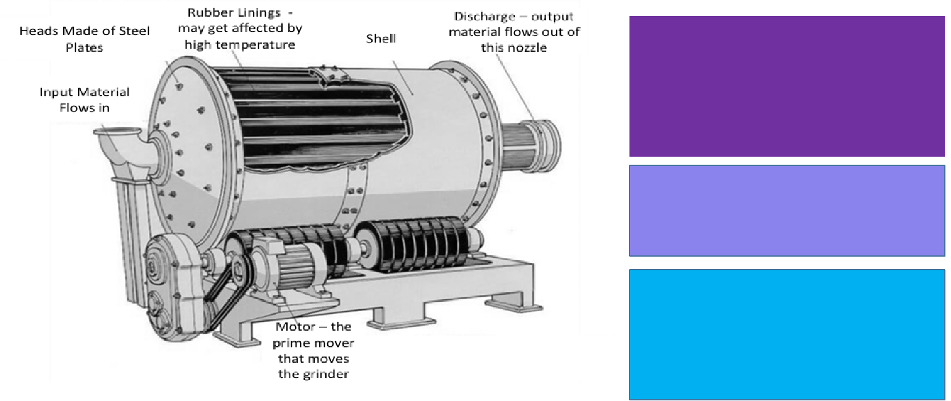
BENEFIT ESTIMATION EXAMPLE
Max. predicted probability | Min. predicted probability | Avg. predicted probability | Windows where a breakdown was observed | Windows where a breakdown was not observed
100.0% | 43.1% | 57% | 123 | 99
42.6% | 31.3% | 32% | 77 | 140
30.1% | 24.2% | 28% | 67 | 152
24.1% | 19.0% | 22% | 52 | 156
18.7% | 13.2% | 15% | 31 | 189
12.8% | 10.1% | 11% | 23 | 195
9.4% | 7.3% | 8% | 18 | 205
6.4% | 3.1% | 5% | 13 | 199
2.5% | 1.8% | 3% | 8 | 206
1.5% | 0.0% | 2% | 6 | 231
The cost of each shutdown is $100k
The cost of a failure is $150k
Whenever there is a failure, one must shut down the plant as well. So, the total cost incurred in case of failure is $250k
What is the maximum benefit that one can obtain from this model?

Slide 23
BENEFIT ESTIMATION EXAMPLE - BASELINE
Max. predicted probability | Min. predicted probability | Avg. predicted probability | Windows where a breakdown was observed | Windows where a breakdown was not observed
100.0% | 43.1% | 57% | 123 | 99
42.6% | 31.3% | 32% | 77 | 140
30.1% | 24.2% | 28% | 67 | 152
24.1% | 19.0% | 22% | 52 | 156
18.7% | 13.2% | 15% | 31 | 189
12.8% | 10.1% | 11% | 23 | 195
9.4% | 7.3% | 8% | 18 | 205
6.4% | 3.1% | 5% | 13 | 199
2.5% | 1.8% | 3% | 8 | 206
1.5% | 0.0% | 2% | 6 | 231
Base line
No of breakdowns in a year | 418
Cost (@250K per breakdown) in Million | 104.5

Slide 24
BENEFIT ESTIMATION EXAMPLE – STRATEGY-1
Max. | Min. | Avg. | Windows where a breakdown was observed | Windows where a breakdown was not observed
predicted probability | predicted probability | predicted probability
100.00% | 43.10% | 57% | 123 | 99
42.60% | 31.30% | 32% | 77 | 140
30.10% | 24.20% | 28% | 67 | 152
24.10% | 19.00% | 22% | 52 | 156
18.70% | 13.20% | 15% | 31 | 189
12.80% | 10.10% | 11% | 23 | 195
9.40% | 7.30% | 8% | 18 | 205
6.40% | 3.10% | 5% | 13 | 199
2.50% | 1.80% | 3% | 8 | 206
1.50% | 0.00% | 2% | 6 | 231
Base line
No of breakdowns in a year | 418
Cost (@250K per breakdown) in Million | 104.5
If our strategy is to shut down the machine if the probability of breakdown is more than 31.3%
No of breakdown in a year - false negatives | 218
Cost (@250K per breakdown) in Million | 54.5
No of shutdown without break down - false positives | 239
Cost (@100K per breakdown) in Million | 23.9
Total cost | 78.4
Cost save compared to baseline | 26.1

Slide 25
BENEFIT ESTIMATION EXAMPLE – STRATEGY-2
Max. | Min. | Avg. | Windows where a breakdown was observed | Windows where a breakdown was not observed
predicted probability | predicted probability | predicted probability
100.00% | 43.10% | 57% | 123 | 99
42.60% | 31.30% | 32% | 77 | 140
30.10% | 24.20% | 28% | 67 | 152
24.10% | 19.00% | 22% | 52 | 156
18.70% | 13.20% | 15% | 31 | 189
12.80% | 10.10% | 11% | 23 | 195
9.40% | 7.30% | 8% | 18 | 205
6.40% | 3.10% | 5% | 13 | 199
2.50% | 1.80% | 3% | 8 | 206
1.50% | 0.00% | 2% | 6 | 231
Base line
No of breakdowns in a year | 418
Cost (@250K per breakdown) in Million | 104.5
If our strategy is to shut down the machine if the probability of breakdown is more than 19%
No of breakdown in a year - false negatives | 151
Cost (@250K per breakdown) in Million | 37.75
No of shutdown without break down - false positives | 391
Cost (@100K per breakdown) in Million | 39.1
Total cost | 76.85
Cost save compared to baseline | 27.65

Slide 26
TECHNOLOGY
Technology for building ML models
Technology for implementing models
Intermediate very high compute requirement vs continued moderate compute requirement
Scalability, high availability and fault tolerance
Intelligent choice of technology – not every processing requires the most latest technology. Critically evaluate technology choices
Open source vs proprietary tools
Intelligent usage of the cloud
Implementation consideration: Orchestration, batch processing, stream processing

Slide 27
DATA ENGINEERING
Data producer characteristics
Data consumer characteristics
Characteristics of the data
Data engineering design
+
+
=
Streaming producer
Batch producer – produced any time
Batch producer – produced at predetermined intervals
Generated by the ‘human hand’
Generated by machines
Streaming real-time data consumption
Near-real-time consumption
Batch consumption
Ad hoc consumption
Hot storage
Cold storage
Structured
Unstructured
Size of data that is being stored
Size of data that is being processed
Velocity of data
Will not choose Kafka for communication between applications or for running background jobs
Will not use Kafka if the size and frequency of data is not huge
Converting a SQL to NoSQL is not a piece of cake (Ask Uber)
Hadoop runs on commodity hardware
Spark is fast because it runs on memory (Nothing new in the concept)
Writing few records to database – Don’t use Spark
A MySQL query is always easier than a MongoDB query
Ingestion - Flume, JDBC, Kafka, RabbitMQ, Kinesis, NiFi
Processing – Java Springs, Python, Spark, Tez, MapReduce
Storage – RDBMS, HDFS, NoSQL
Automation workflow – Airflow, Oozie, Azkaban, Cron Jobs

Slide 28
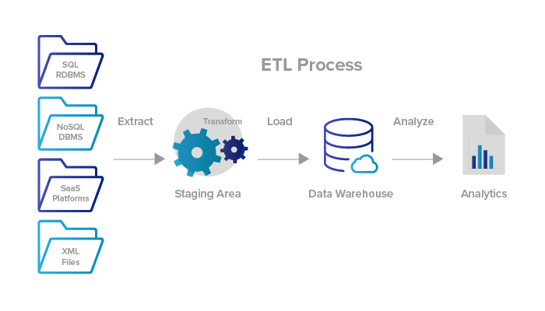



IMPLEMENTATION
Batch Processing
Stream Processing
Deployment as APIs vs batch
Real-time data fetching
Requirement of zero data loss for stream processing
Disk vs in-memory processing
Scalability
Deployment as microservices
High availability
Using Lambda and similar cloud architecture
Model governance and tracking
Batch Processing

Slide 29
HUMANS
Change management
Fear of loss of control
Confidence in machine intelligence
Fixing responsibility if something goes wrong
Providing explainability for all solutions involving automation of subject matter expertise
Data ownership
Ownership of asset created using the data
What if a customer wants to exclude her data from AI model building?
Explainability to customers
Fear of not being able to interact with humans
Privacy concerns
Controlling decision automaton
And many more that we are yet to witness

Slide 30

HUMANS: THE RIGHT SKILL
Consolidate existing data
Hunt for new data
Build algorithms
Right skill
BUSINESS IMPACT
+
+
+
=
Skills of a Data Scientist
Understands business
Understands quants
Understands the data of the organisation
Understands technology
Is able to handle change management
Is an excellent project manager
Is an excellent storyteller
Capability Development Cycle
1
2
Business
2
1
3
3
Technology
Data Science

Slide 31
PRIVACY AND OTHER CONCERNS
Data privacy and security are the first steps
Key regulation: GDPR, Truth of Lending Act, Facebook and Cambridge Analytics Controversy, controversy over recommendations, opinion building, news and content filtering, and many more
We will see evolution towards
Right to forget
Right to exclude data from intelligence creation
Movement of data across regions
Reason codes and transparency while models are used for decision-making
Abuse and discrimination
Ethics of machine learning and AI
Job loss, which though often discussed, is probably not the most important aspect
Responsibility and accountability when a model is used for decision-making
Identifying and handling black swan events
Discrimination and bias
Fear of loss of control
Ownership of data and the rise of the big brother

Slide 32
Case Studies

Slide 33
CASE STUDY-1
You are the digital head of an auto insurance company
Currently, for renewing policies, the company follows the process mentioned below
One month before the renewal date, an email is sent to the customer with a customised link
The customer needs to upload any one KYC document (PAN, passport, driving license, Aadhar card) in the link
This document is reviewed by the back-end team. The document must satisfy the following conditions
It must be one of the three KYC documents submitted during the initial policy issuance
It must match the KYC document in terms of the number and photograph (e.g., PAN no, driving license number)
Once the document has been verified, a payment link is sent to the customer via email
Once the customer makes the payment, the new policy is issued to the customer. The soft copy is shared via email, and the hard copy is sent by physical mail
How can we reimagine the process and identify how you will use AI to reimagine the process?

Slide 34
CASE STUDY-2
You are the Head of Data Science at a bank
One of the key cross-sell offers that the bank boasts of is the cross-sell of personal loans to credit card customers
The credit card interest rate is ~35% per annum for revolvers (people who do not pay the full amount due). The interest rate for personal loan varies from 12% to 18% per annum depending on the customer profile
There is an existing cross-sell model that has been developed to target potential credit card customers for personal loans
If your team is tasked with redeveloping the model, what approach will you suggest?

Slide 35
CASE STUDY-3
You are the Head of Data Science at a telecom company
Your team has developed a churn model to predict customers who have a higher propensity to churn in the next three months
What information will you need from the business to quantify the business benefits of the model?

Slide 36
CASE STUDY-1: KEY METRICS
Customer satisfaction and low NPS due to a lengthy renewal process
Cost of renewal process
Customer attrition – customers accepting a competitor’s offer
How to address the challenges – automate the process and make it relevant to real time. Eliminate any human intervention
What is the need to automate the process?
Identify the KYC document and match it with the types of KYC documents that were received while onboarding the customer
Extract information from the KYC documents
This is an example where we are attempting to replicate ‘human intelligence’ and not ‘subject matter expertise’
Solution structure
Model1: Given a KYC document, identify the type
Model2: From a KYC document, extract information and create a structure; e.g., identify name, address, ID, etc.
Leverage a pretrained model such as ImageNet to train model1
Leverage OCR and text mining for model2

Slide 37
CASE STUDY-1: SOLUTION EVALUATION
Impact of false positive: Wrong policy issuance
Impact of false negative: Customer is redirected to the manual processing route
Cost of false positive may be higher
Implementation
Start with a threshold such that false positives are minimised, and track the proportion of manual processing. Over time, fine-tune the model to reduce the proportion of manual processing

Slide 38
CASE STUDY-1: SOLUTION EVALUATION
Technology infrastructure
The speed of processing will have a major impact on customer satisfaction
Determine how to handle high loads and concurrency. Identify the need for high availability so that customers are not left ‘stranded’ when one of the servers is down
Identify the need for encryption while exchanging data with document management and policy renewal systems. This is critical, as we are dealing with sensitive KYC information
Question: Can we have an edge implementation of the solution?
Benefit assessment
Conduct pre-post analysis before and after model implementation; a test control may not be required in this case
Identify the cost of low customer satisfaction and NPS
Cost of processing and cost of attrition will be easier to establish

Slide 39
CASE STUDY-2: KEY METRICS
Revenue from credit card
Revenue from personal loan
Default and credit loss
How to address the challenges – the credit card interest rate is significantly higher than personal loan interest rate. But for credit cards, the bank will earn interest only if the customer revolves (makes partial payment). Personal loan also involves an increase in the exposure at one go, instead of a credit line. So the losses may be higher
What does the bank need?
A model to predict cross-sell is only a small part of the solution
A comprehensive optimisation framework is required to take into account the multiple drivers of profitability at the customer level
List the data sources that can be used
Solution structure
Model1: Predict cross-sell
Model2: Predict cannibalization of credit card revenue
Model3: Predict incremental loss
Model4: Integrative optimisation framework

Slide 40
CASE STUDY-2: OPTIMISATION FRAMEWORK
Optimise the final profit, given constraints around the balance targets
Test-control the set-up to monitor customer behaviour with regard to change in credit card behaviour and impact of competition
Revenue from personal loan
Revenue from credit card spend (interchange)
Revenue from credit card revolve (interest)
Credit card customer base
Eligible for cross-sell (satisfies the risk requirement)
Cross-sell model
Cannibalization in credit card spend revenue
Incremental financial benefit
Cannibalization in credit card revolve revenue
Competition offering a personal loan
Risk of default on personal loan
Incremental risk of default on credit card due to over-leverage

Slide 41
CASE STUDY-2: OPTIMISATION FRAMEWORK
Data sources
Card transaction, balance and payment data
Credit bureau data for the external view of the customer
Response to past campaigns
Implementation
Real-time implementation across the Web, app, ATM, WhatsApp
Inbound call sales leveraging
Batch implementation as outbound calling
Customer fatigue and contact frequency

Slide 42
CASE STUDY-3: KEY METRICS
Churn rate and loss of revenue due to churn
Cost of retention
Customer satisfaction and NPS
How to address the challenges – proactively identify potential churn and identify the offer that could help retain those customers
What are the determinants of a successful churn prediction model?
You may have a model that predicts churn accurately. How will you use the model to identify the reason for churn for a specific customer?
How will you use external factors in the model?
What are the data sources that you can consider?
Solution structure
Model to predict churn
Identify retention strategy basis the model

Slide 43
CASE STUDY-3: SOLUTION EVALUATION
What will be the impact of false positives and false negatives?
Cost of false positive: The person was not about to churn; so, they will walk away with the offer
Cost of false negative: You will fail to identify a potential churn
Save rate: Even if you are able to identify a potential churn, you may not be able to save the customer
Data sources
Usage data
Network data – call drops, poor network, etc.
Transaction and payment data
Complaints data
Call centre, Web and app data
Call recordings
Some of the unstructured data sources – call recordings, complaints text, etc.
Can we use qualitative and quantitative surveys to have a better understanding of the customer and the reason of churn?

